Slide 1
Spatial Analysis and Modeling BIOL 4383/6383-02
Week 1:
Intro to Landscape Ecology & GIS

Slide 2
What is Landscape Ecology?
Spatially-Explicit Understanding of Ecological Pattern and Process
Evolutionary Patterns Can be Integrated Too!
Focus on Understanding Causes and Consequences of Spatial Heterogeneity
Can be VERY Interdisciplinary
See various researchers’ interpretations here: http://www.usiale.org/what-landscape-ecology
Notes:
Couple minute discussion about Landscape Ecology

Slide 3
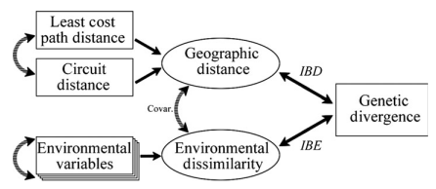
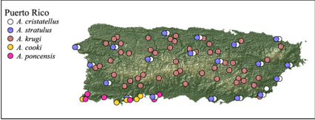
A few applications…
Understanding Phylo/Biogeographic Patterns
Wang et al 2013. Ecol. Letters

Slide 4
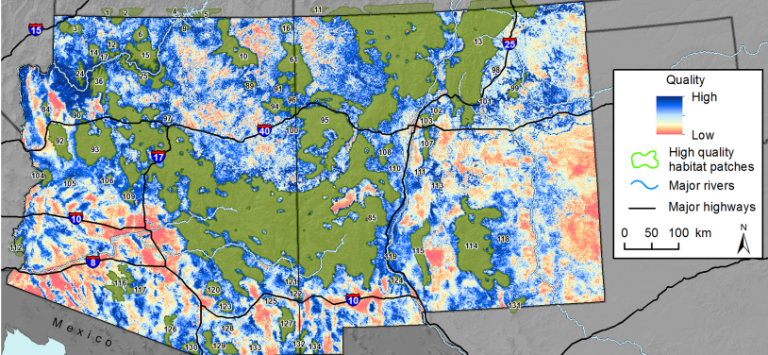
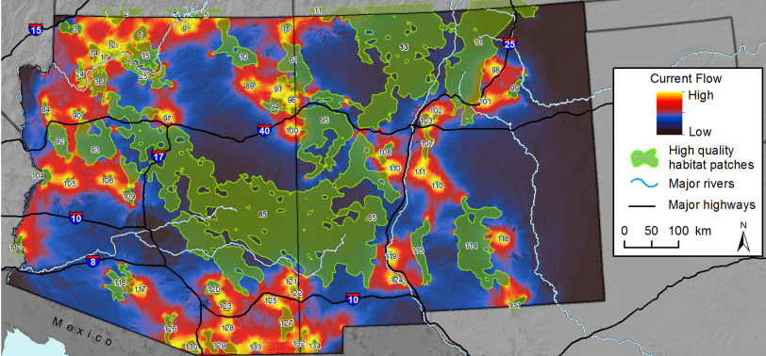
A few applications…
Understanding Phylo/Biogeographic Patterns
Species Distributions and Connectivity
Wang et al 2013. Ecol. Letters
Dickson et al 2013. PLoS ONE

Slide 5
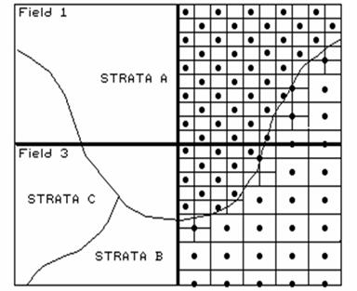
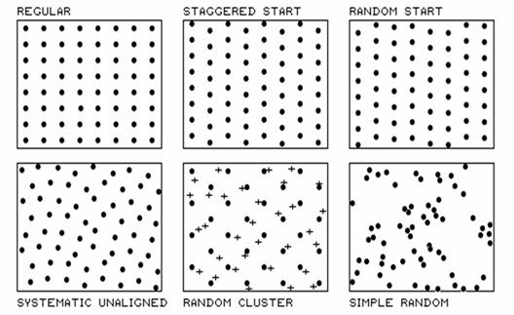
A few applications…
Sampling Design
http://www.innovativegis.com/basis/mapanalysis/Topic3/Topic3.htm

Slide 6
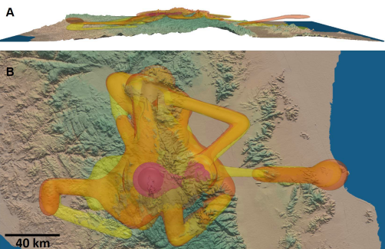
A few applications…
3-D Analyses and Visualization
California Condors – Tracey et al. 2014 PLoS ONE

Slide 7
Course Goals
Understand Importance of Incorporating Spatial Relationships in Data into Analyses
Use Spatial Relationships in Data to Make Inferences using Modern Statistical Techniques.
Become Familiar with Modern Computing Tools Including GIS and R for Statistical Computing

Slide 8
Grades/Expectations

Slide 9
Introductions
Name
Research Interests
Why you’re in this class/something you hope to learn

Slide 10
Goals for the Week
A Crash Course in GIS
Data Types
Geodetic Datums, Projections, and Coordinate Systems
Some Manipulations
Software
Tutorial with QGIS
Some basic workflows
Making a Map

Slide 11
Introduction to Spatial Data/GIS

Slide 12
GIS: Geographic Information Systems
From the ESRI (ArcGIS) Website:
“A geographic information system (GIS) lets us visualize, question, analyze, and interpret data to understand relationships, patterns, and trends. GIS benefits organizations of all sizes and in almost every industry. There is a growing interest in and awareness of the economic and strategic value of GIS.”

Slide 13
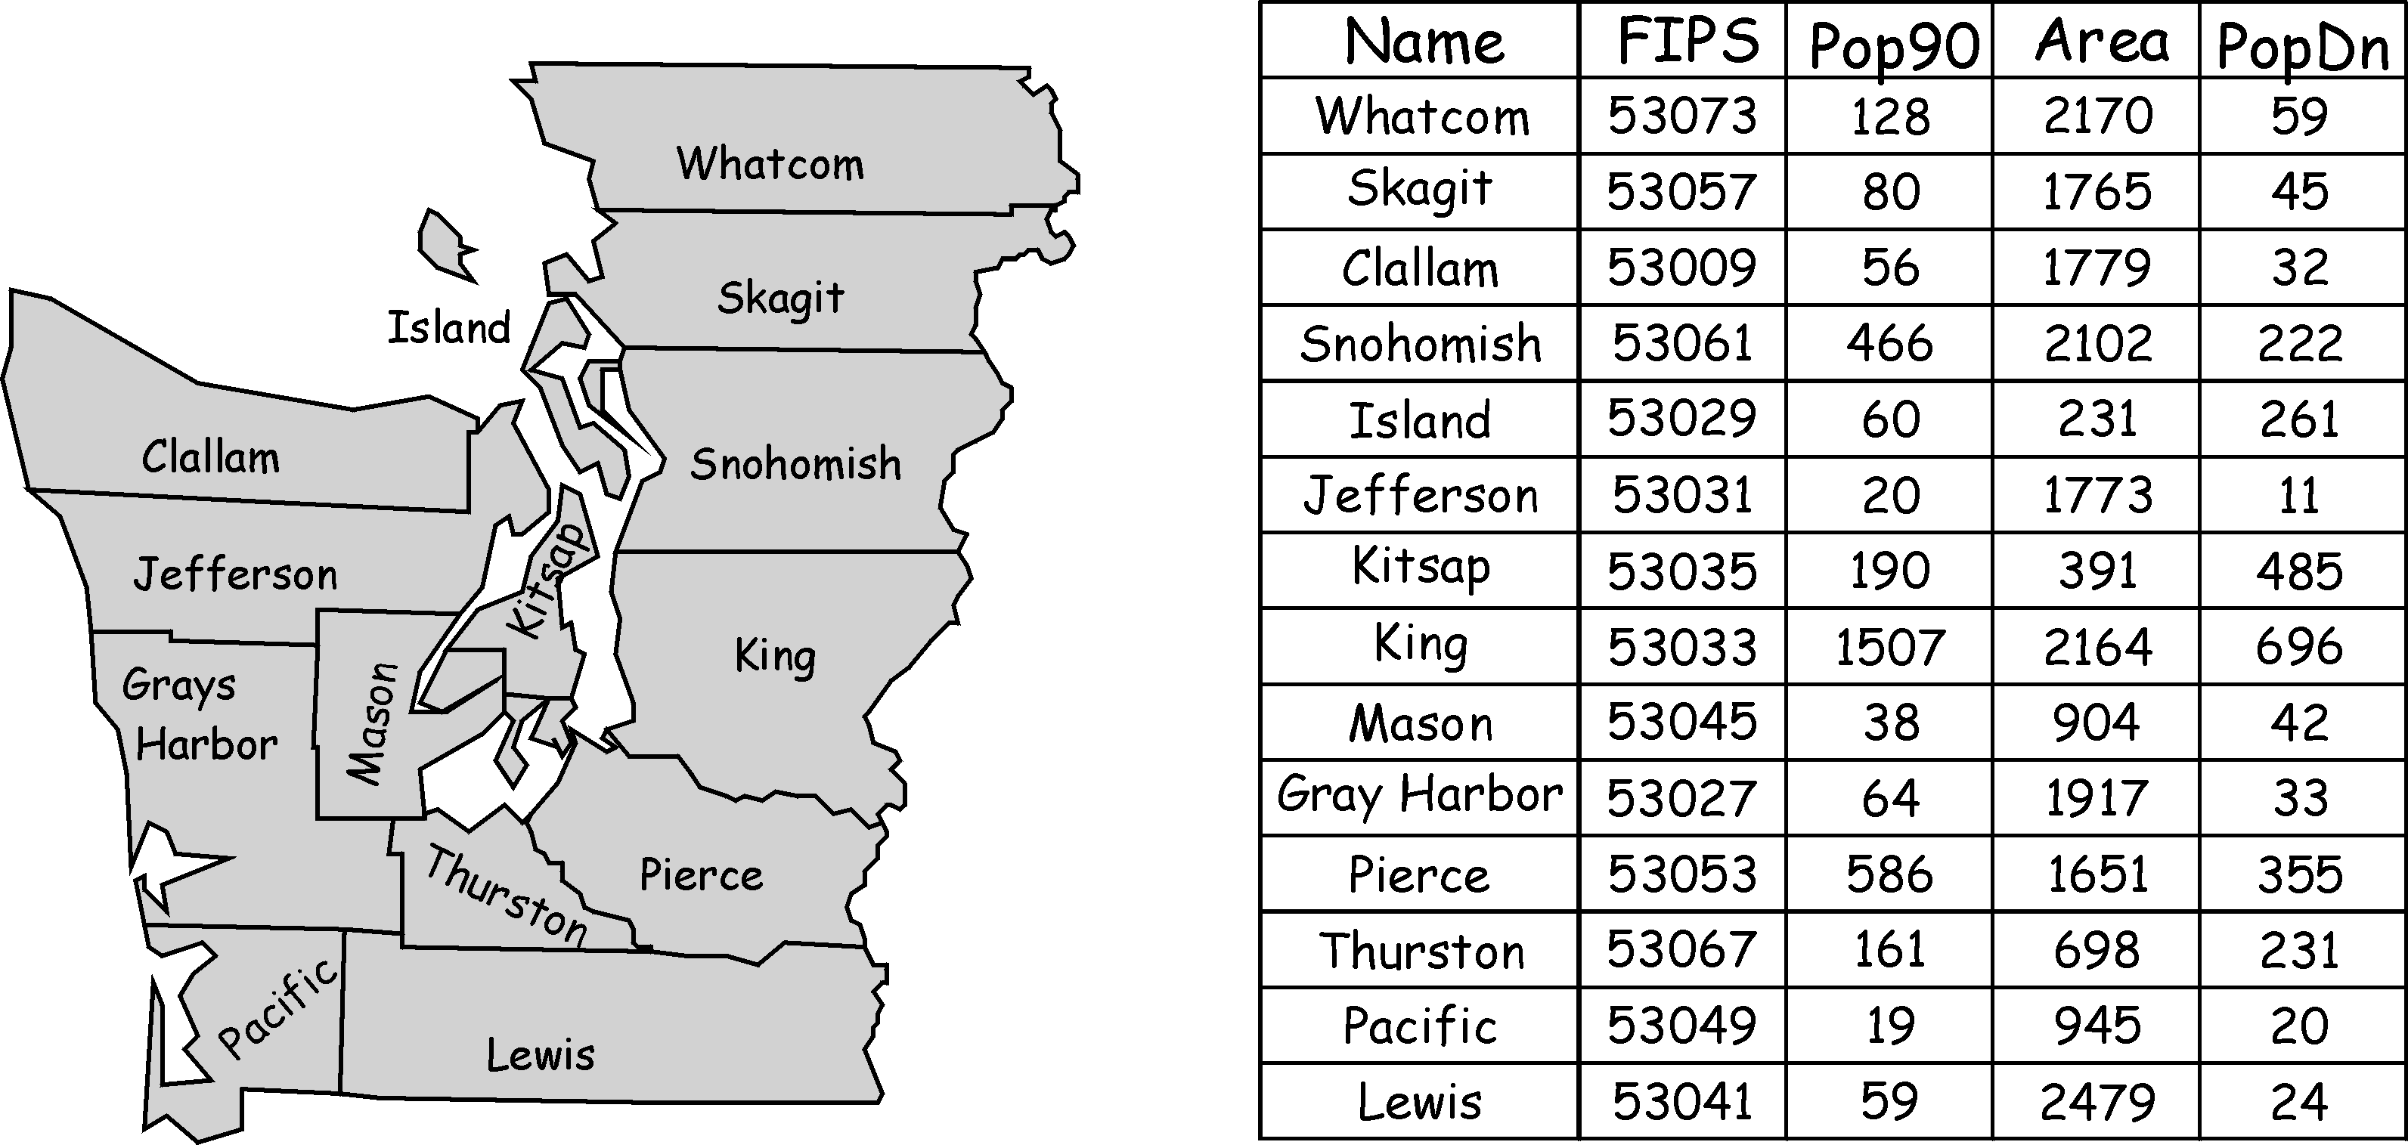
Fundamentals: Vector Data
Lines, Points, Polygons
Each Individual Element Referenced in an Attribute Table
Many Different Types of Data Can be Stored for each Record

Slide 14
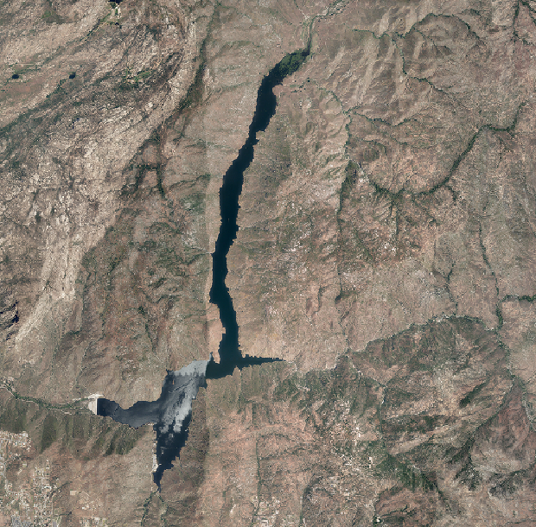

Fundamentals: Raster Data
Pixels [Picture Elements]
Think Digital Photograph

Slide 15
Fundamentals: Raster Data
One Datum Per Pixel Per Layer
Some Imagery is Multiple Layers (bands)
On Data-Type per Layer (e.g., Integer, Floating Point, etc.)
Examples:
Digital Elevation Model (Continuous Data)
Land Cover Classification (Categorical Data)

Slide 16
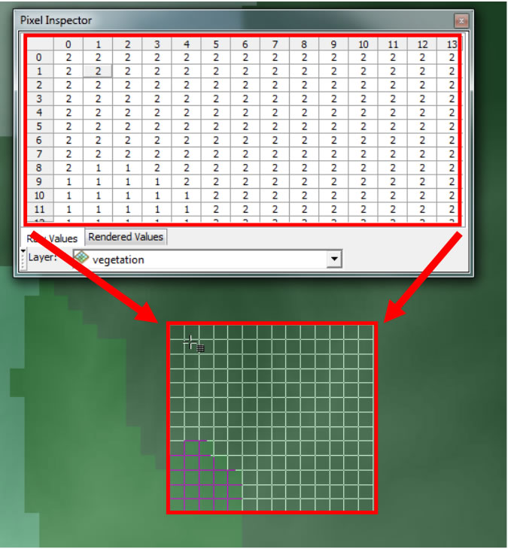
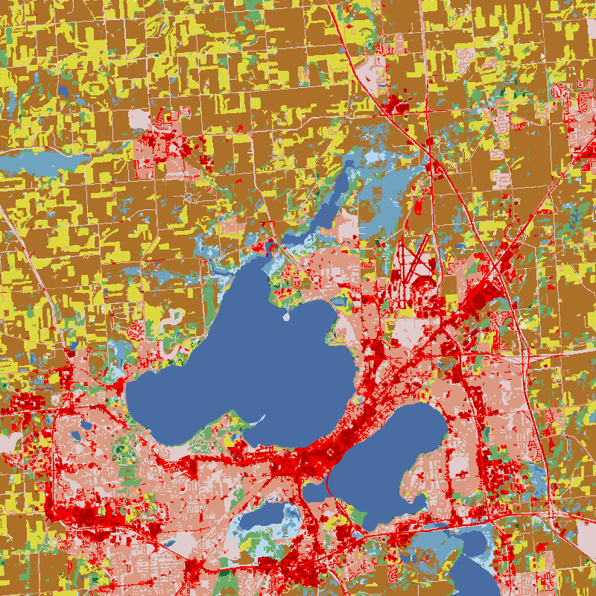
Fundamentals: Raster Data

Slide 17
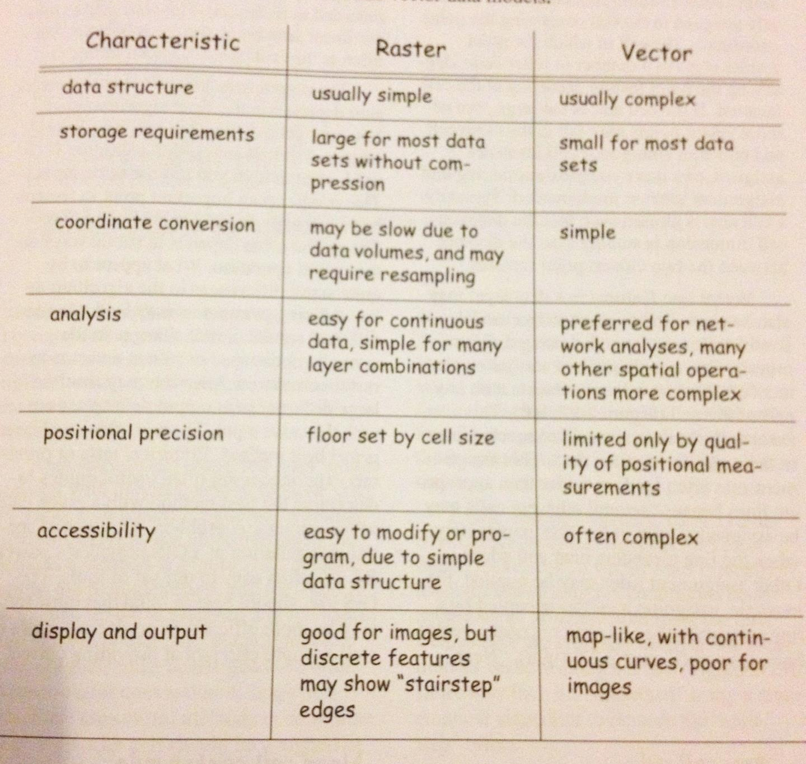
From Bolstad, GIS Fundamentals

Slide 18
Common Formats (There are Many More!)
Vector Data: Shapefiles (.shp); GPX; DXF
Raster Data: GeoTIFF; ECW; ASCII; .IMG
Raster or Vector: .GDB (ESRI Proprietary); KML (Google Earth); GeoPDF (Proprietary)

Slide 19
Coordinate/Spatial Reference Systems
3 Elements:
Geodetic Datums
Projections
Coordinate Systems

Slide 20
Geodetic Datums
Earth is NOT a Perfect Sphere
We have multiple representations of it based on an oblate spheroid and measured distances among known points on Earth (Geodetic Datums)
E.g., North American Datum 1927 (NAD27); NAD 83; World Geodetic Survey 1984 (WGS84).
Things are Mapped with GPS Units/Survey Equipment According to Specific Datums

Slide 21
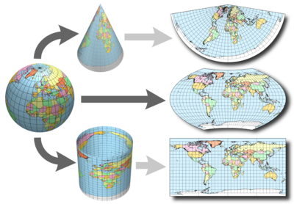
Projections
Maps are Flat Representations of Earth’s Surface
Many ways to Do This; each with pros/cons
Conic
Pseudocylindrical
Cylindrical

Slide 22
Coordinate Systems
WHERE ON EARTH ARE WE?!?!?!
Multiple Coordinate Systems to Represent This
E.g., Latitude/Longitude; UTMs
Goal is to Give Accurate Representation of Location Relative to Other Locations
Coordinate Systems are Associated with Specific Projections (generally Implicitly)

Slide 23
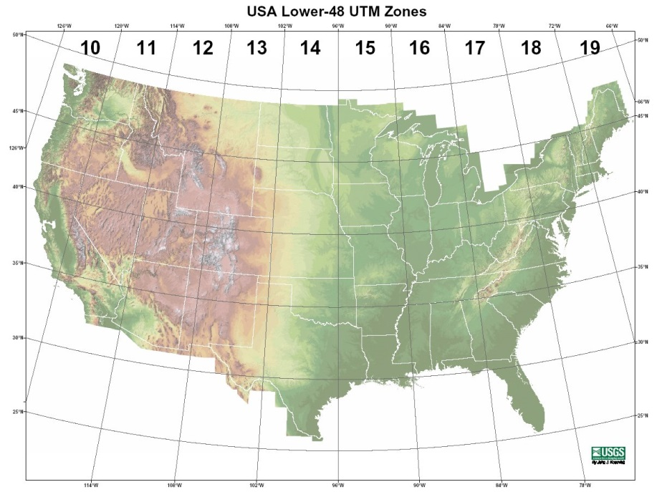
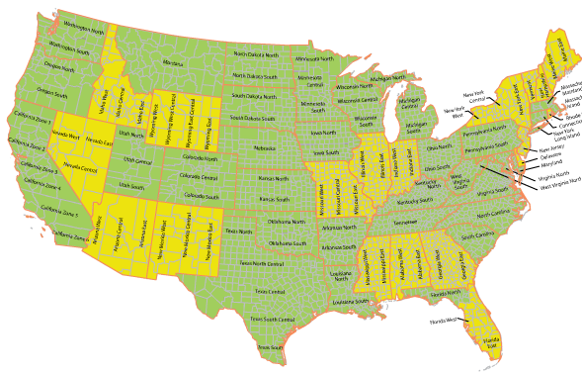
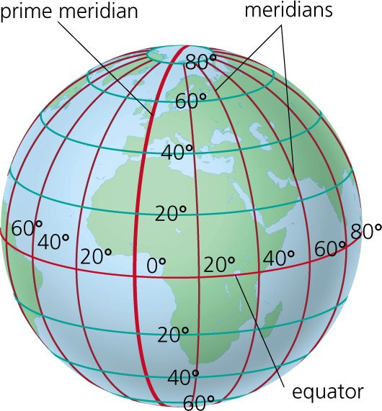
Coordinate Systems
UTM
-Meter-Based, from a Conformal Projection [preserves angles locally])
State Plane Coordinate Systems
Based on Lambert Conformic Conic or Universal Transverse Mercator Projction (Depends on State)
Latitude/Longitude
-Based on Specific Datums

Slide 24
Using Coordinate Systems in GIS
http://spatialreference.org/
We Often Need to Define or Transform Reference Systems
The Above Website Serves as a Clearinghouse for Spatial Reference Codes and Data, Based on Various Codes
THINGS CHANGE WHEN YOU DO THIS!!!
But We Don’t Always Have Alternatives…
http://bost.ocks.org/mike/simplify/
http://bost.ocks.org/mike/example/

Slide 25
Some Basic Manipulations
Vector Operations
Clipping
Spatial Join/Overlay
Create Centroids

Slide 26
Some Basic Manipulations
Raster Operations
Crop/Clip (change extent)
Rescale/Resample (change grain size)
Raster Algebra/Map Math

Slide 27









Some Common Software Tools
Paid Software
Free and Open Source (FOSS)
Many Integrate with Each Other

Slide 28
Lets Explore QGIS
(Before I Forget- Reading Assignment for Thursday)

